Slide 1
Introduction to Research Data Management with openBIS
Caterina Barillari & Priyasma Bhoumik
Scientific IT Services, ETH Zurich
ETH Zurich, 17.11.2020
Notes:
Introduce ourselves
Mention that slides will be made available!

Slide 2
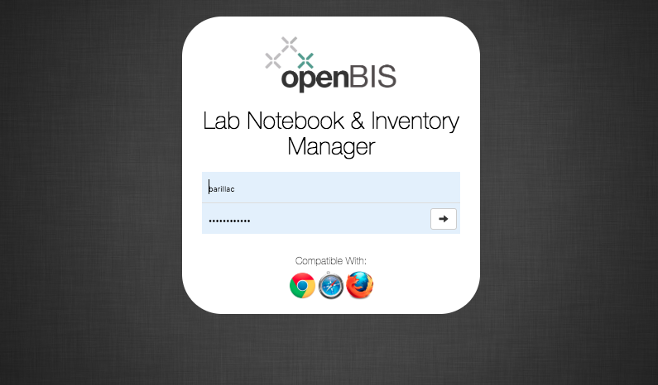
https://openbis-training.ethz.ch/openbis/webapp/eln-lims/?

Slide 3
Overview of training
Introduction to basic openBIS concepts
Hands-on tutorial:
Registration of samples in openBIS Materials Inventory
Registration of protocols in openBIS Methods Inventory
Recording experiments and uploading data in openBIS Lab notebook

Slide 4
Basic openBIS concepts

Slide 5
How to use the openBIS Inventory & Lab Notebook
Inventory
Lab Notebook
Shared by all lab members.
Personal space. Can be shared.
Samples
The complete solution for managing research data
Experiments
Protocols
Raw data
Processed data
Scripts/ Jupyter notebooks
Results

Slide 6
Organization of openBIS Lab Notebook
In the Lab Notebook part of openBIS, usually each user has a personal Space where to organize Projects and Experiments
An openBIS Experiment is a specific scientific question. The single attempt to answer this question can be modelled as Experimental Steps.
Experimental Steps can be linked to Samples, Protocols, other Experimental Steps
Data (raw, processed, analysed, final results) can be attached to Experiments or Experimental steps in Datasets

Slide 7
openBIS data structure
Folder with description
Folder with description
Folder with user-defined properties. There can be several types of Experiment/Collection, each defined by different properties. Example: Microscopy experiment, PCR experiment etc.
Entity with user-defined properties. There can be several types of Objects/Samples, each defined by different properties. Examples: Antibody, Chemical, Sensor, Chip, General Protocol, Experimental Step…
Folder for storing data files with user-defined properties. There can be several types of Data Sets, each defined by different properties.
Space
Project
Experiment/Collection
Object/Sample
Data Set
Data Set

Slide 8
openBIS Lab notebook
User
Project 1, Project 2
Experiment 1, Experiment 2
Step1, Step 2
Raw data, analyzed data, code, etc
Raw data, analyzed data, code, etc

Slide 9
Protocols or Experimental Steps?
Protocols are standard procedures used in the lab that need to be shared with all lab members
Every time a given protocol is followed when performing one Experimental Step, the protocol can be linked as parent and the experimental details should be recorded in the Experimental Step itself.
Protocol
Step 1
Step 2
Experimental Step
Temperature= n °C
Pressure= n Pa

Slide 10
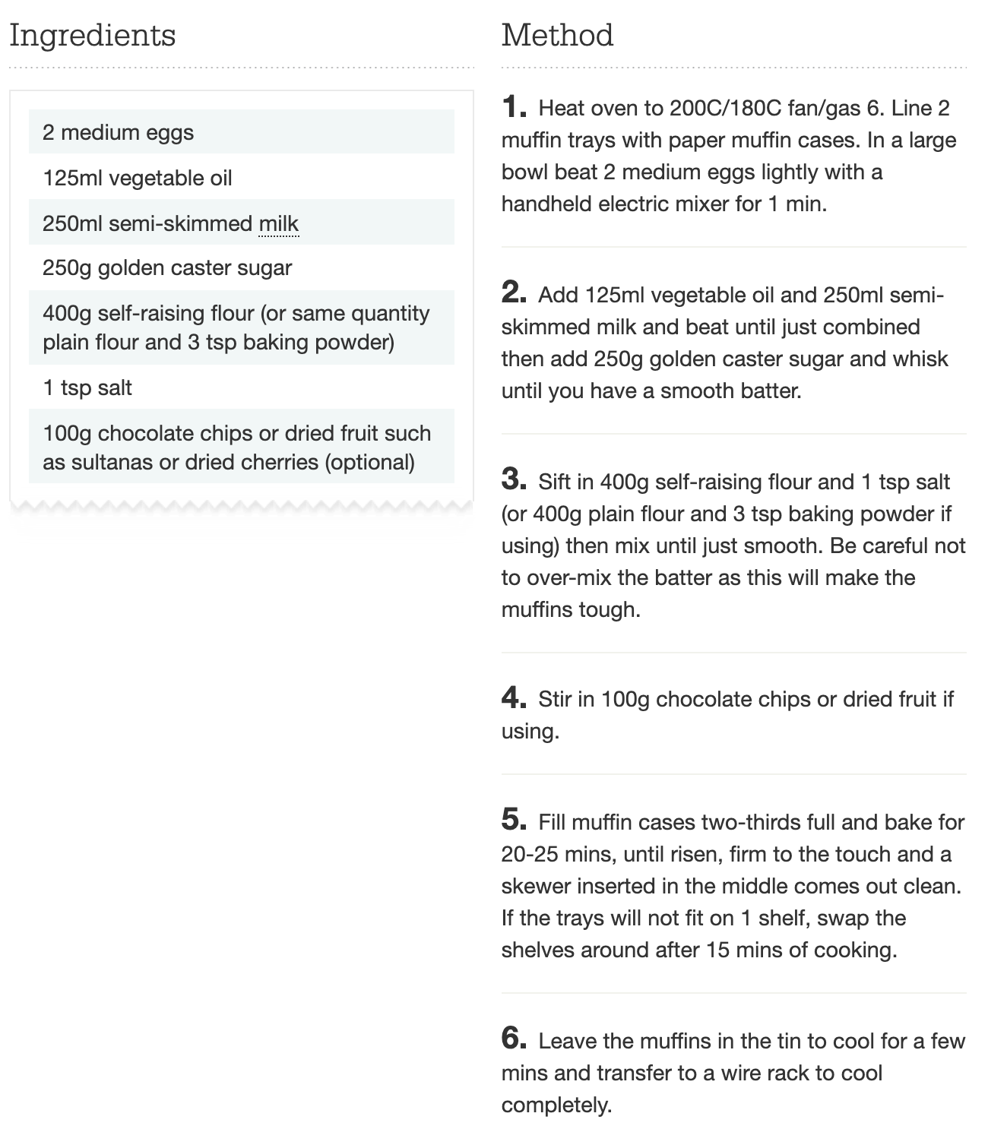
Example
Protocol: muffins recipe
Experimental Step: making muffins
I use 240 ml of whole milk, instead of 250 ml semi-skimmed
I add a teaspoon of sodium bicarbonate
I cook the muffins for 30 mins at 180°C
The protocol gives me directions and defines the steps;
When I perform my experiment I can change some parameters and this needs to be recorded.
www.bbcgoodfood.com

Slide 11
Linking objects and datasets
openBIS objects can be linked to other objects and datasets to other datasets with N:N relationship
In openBIS terms, these are “parent-child” relationships
Object
Data Set
Object
Object
Object
Data Set
Data Set
Data Set
Object
Object
Object
Data Set
Data Set
Data Set
Object
Object
Data Set
Data Set

Slide 12
What are “parents” and “children”?
They are a way of connecting entities together.
Examples:
1. One sample is split into several vials and each of them is used for different types of measurements.
Blood Sample
The Blood Sample is parent of the samples in each vial
Vial 1
Vial 2
Vial 3
2. You write a protocol, and want to keep track of the samples used.
Chemical X
Sample Y
Chemical X and Sample Y are parents of the protocol
Protocol

Slide 13
What are “parents” and “children”?
3. You describe an experiment and you want to keep track of the protocol(s) and samples used
Chemical X
Sample Y
Blood sample
Protocol A and Vial 1 are parents of the Lab Experiment 1
Protocol A
Vial 1
Lab Experiment 1
4. You make one experiment in several steps and you want to link each step to the previous one
Lab Experiment 1
Lab Experiment 2
Lab Experiment 3

Slide 14
Roles
Roles | Capabilities
Observer (Space or Instance) | Read-only access to given spaces or to the whole instance.
Space/Project user | Create + edit Object, Experiment. Edit Project .
Space/Project power user | User rights +create Projects . Delete object, experiment, project, datasets. Add, update vocabulary terms.
Space/Project admin | Power user rights+ list roles; create and delete space roles; edit datasets.
Instance admin | Space admin rights + create types. Has access to everything.

Slide 15
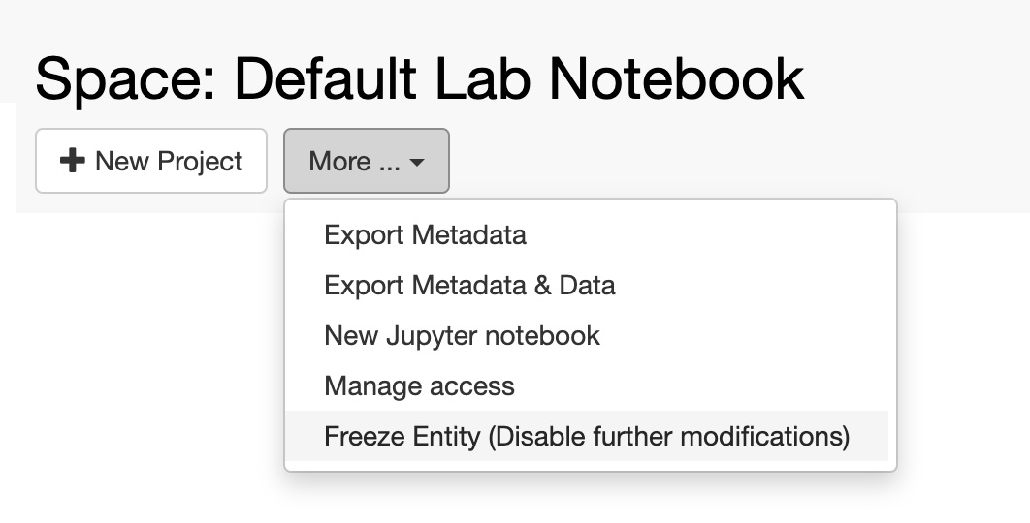
Freezing entities
It is possible to “freeze” every level of the openBIS hierarchy.

Slide 16
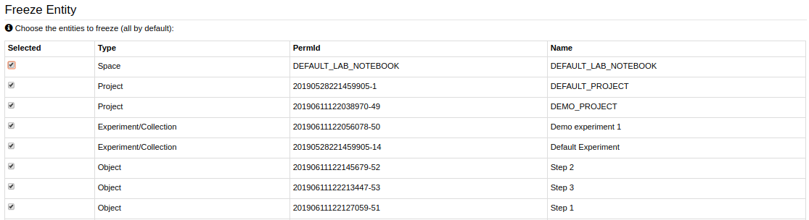
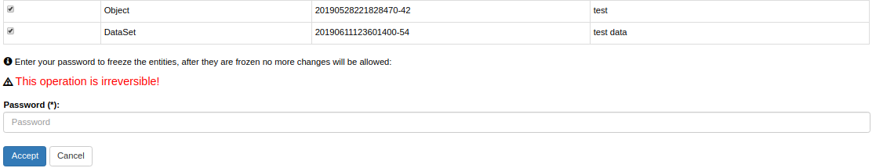
Freezing entities
At every level, everything below is always selected to be frozen. Selection can be modified.

Slide 17
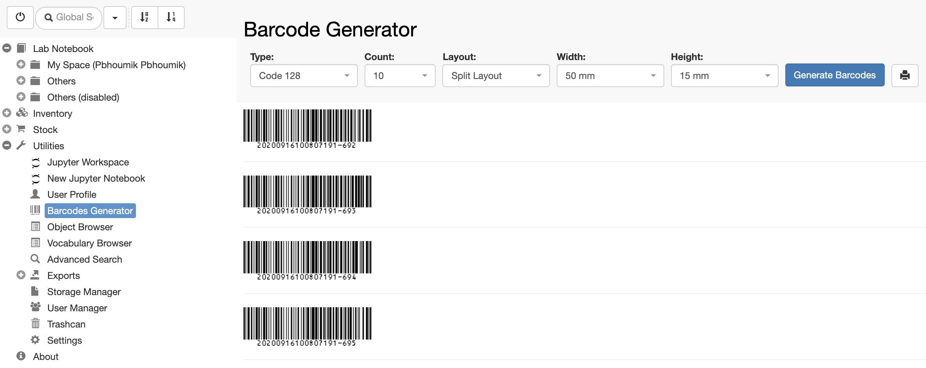
Barcode Generator
Barcodes can be generated & printed after enabling this feature from Settings

Slide 18
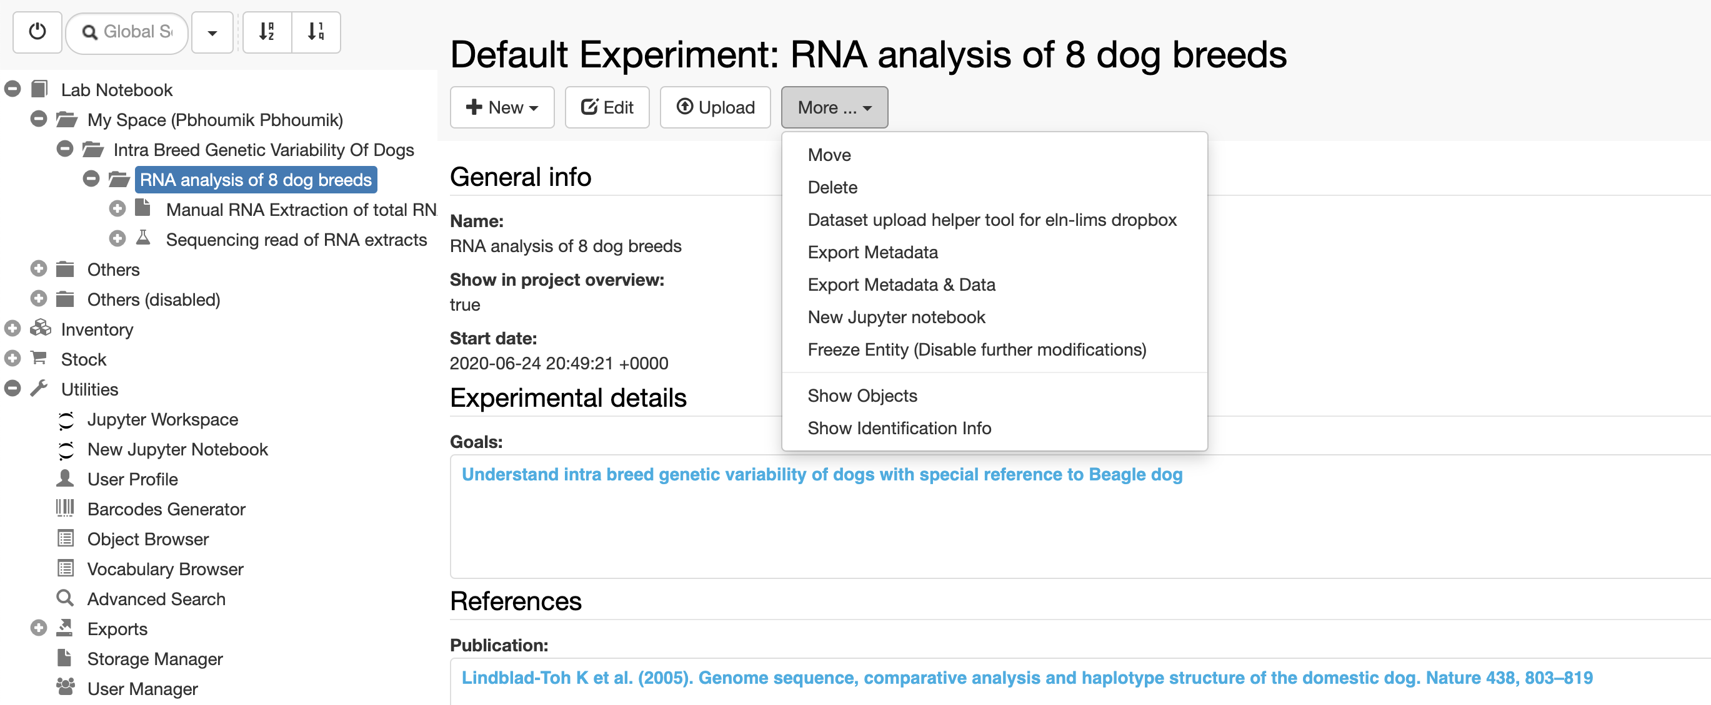
Jupyter Notebook, Dropbox & Archiving
Jupyter notebooks can be used locally or via JupyterHub server for downstream data analysis.
Dropboxes are an efficient tool to help data upload in openBIS. Archiving for LTS (ETH only)

Slide 19
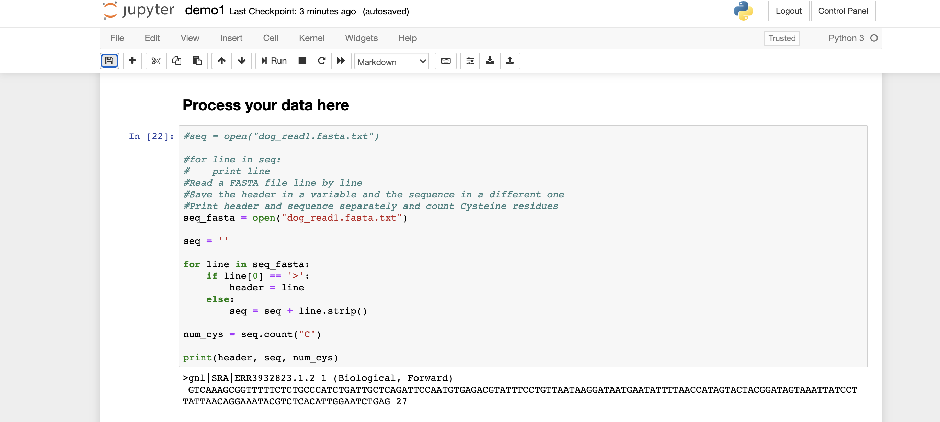
Jupyter Notebook & Dropbox
Jupyter notebooks can be used locally or via JupyterHub server for downstream data analysis.

Slide 20
Overview of today’s openBIS tutorial

Slide 21
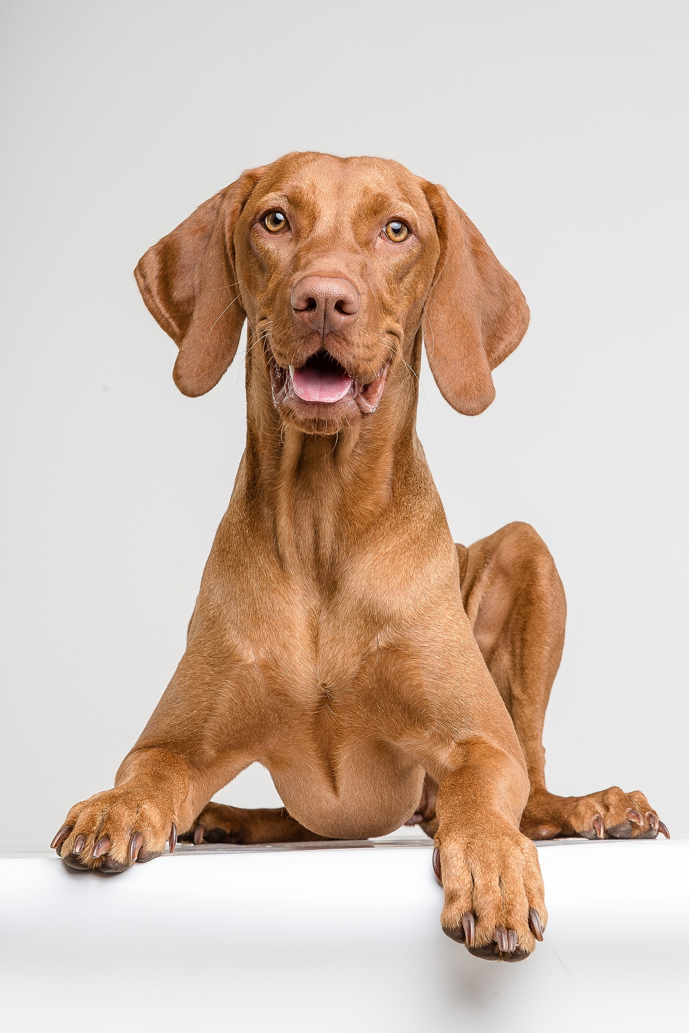
Example: RNA sequencing study of 8 different dog breeds
Goal of the study: understand intra breed genetic variability of dogs with special reference to Beagle dog, since Beagles are used as an animal model for compound testing in the pharma industry.
The eight different dog breeds are as follows:
Beagle
GSD
Golden Retriver
Terrier
King Charles
Poodle
Rottweiler
West Highland White Terrier

Slide 22
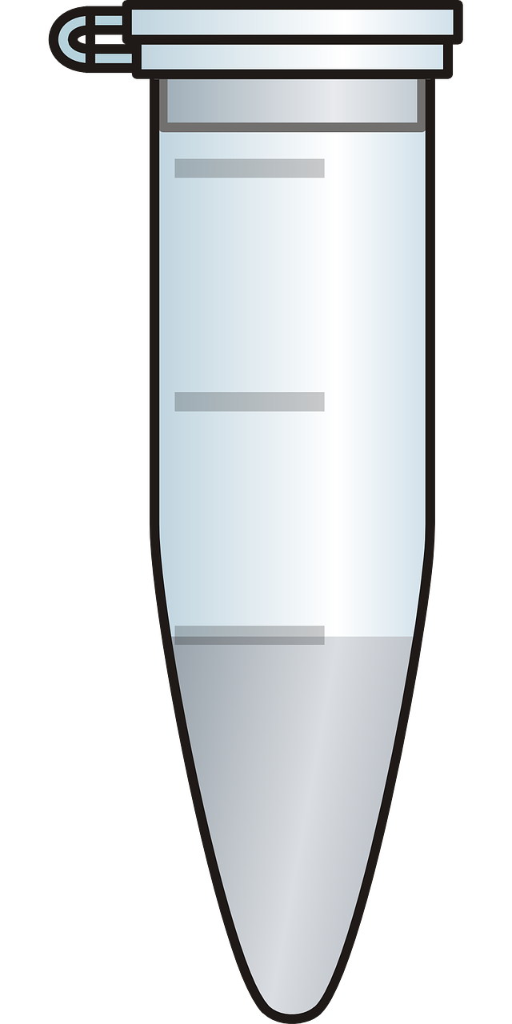
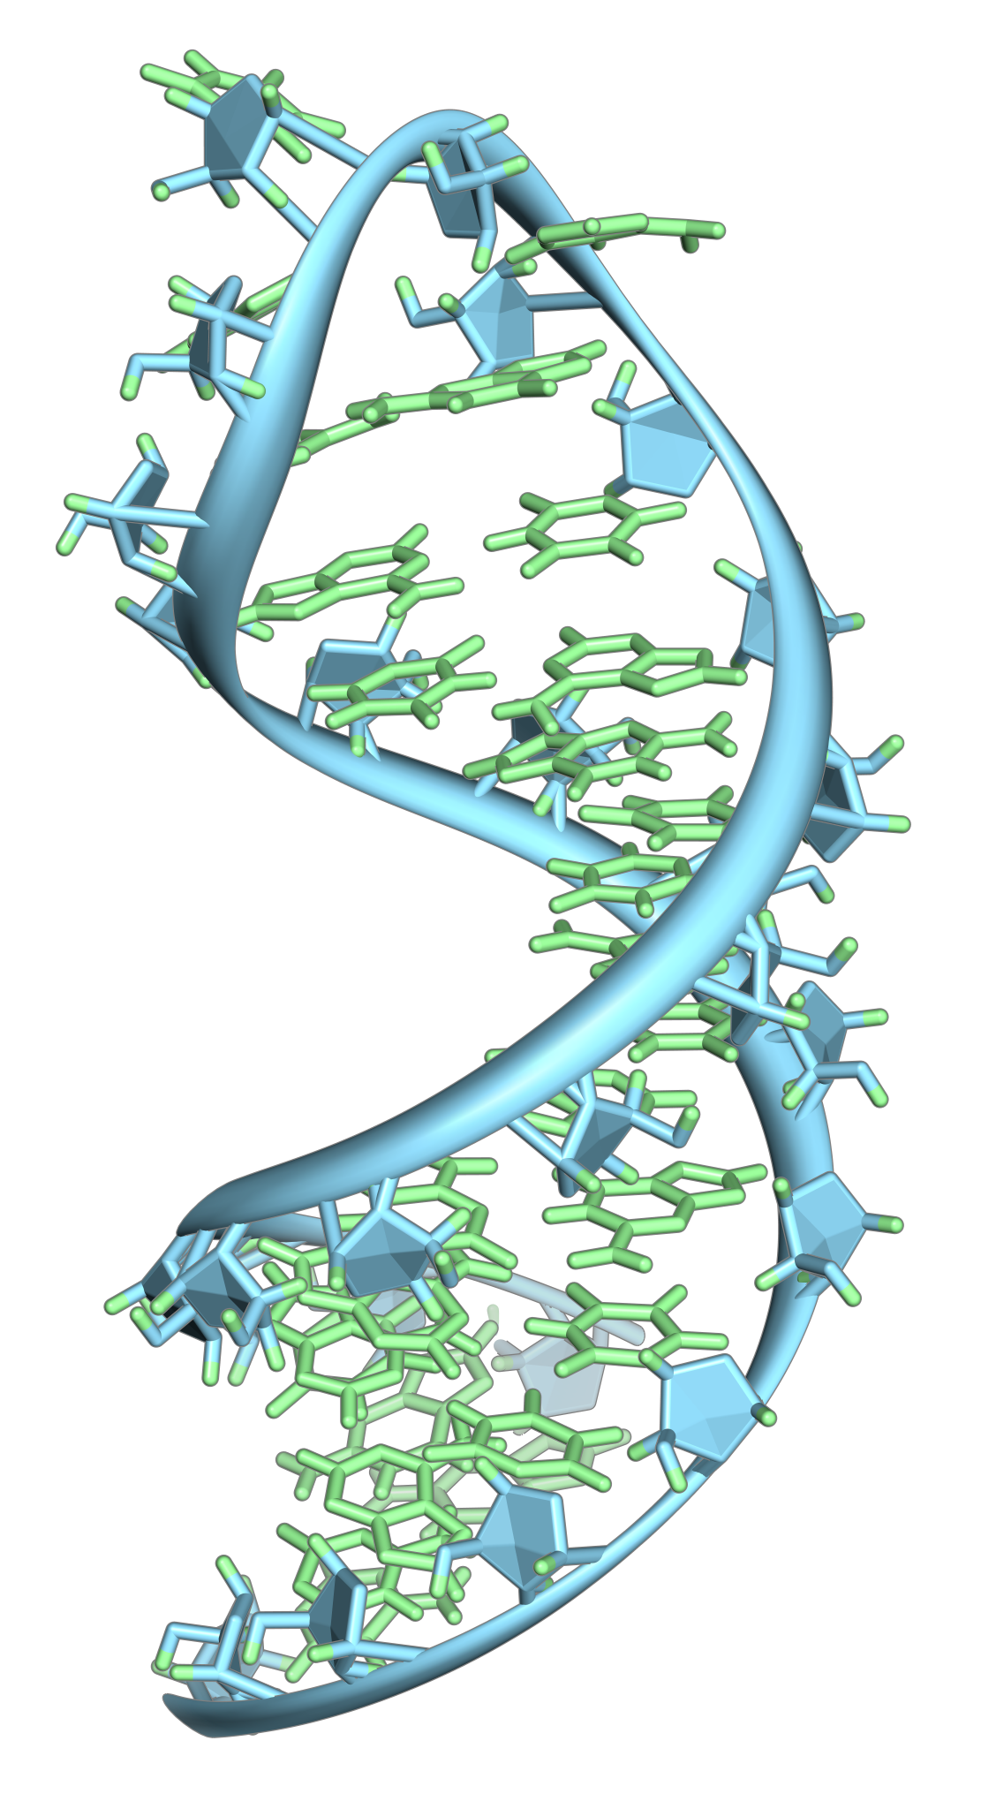

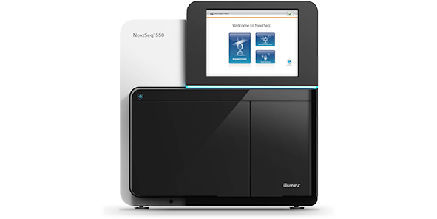
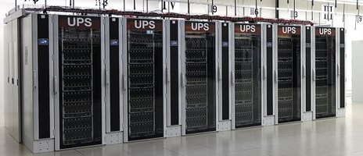
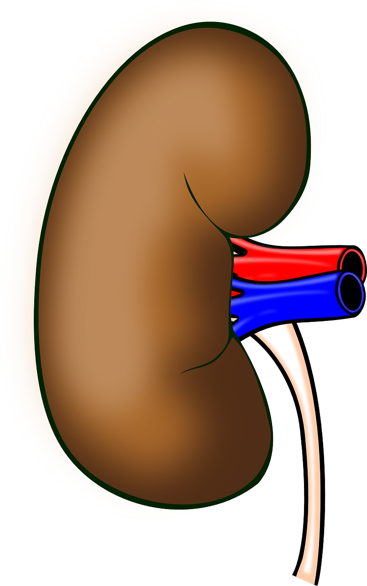
Overview of the study process
By Vossman - Own work, CC BY-SA 3.0, https://commons.wikimedia.org/w/index.php?curid=7115139
Results
RNA extraction from different types of dog tissues
RNA sequencing
Analysis of sequencing data

Slide 23
Overview of the study process
Experiments:
RNA extraction
RNA sequencing
Data analysis
Protocols:
RNA extraction
RNA sequencing
Samples:
Tissues
Chemicals
RNA extracts

Slide 24
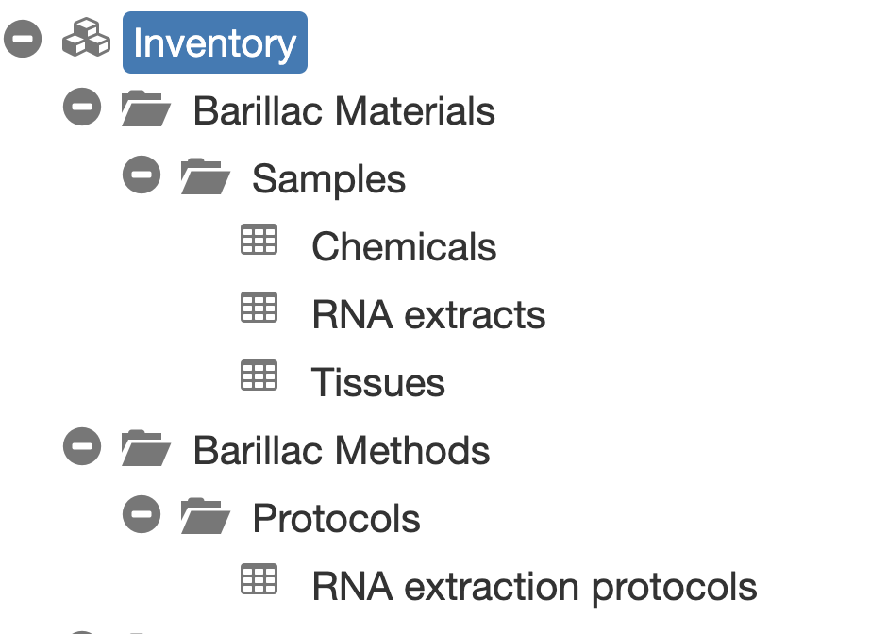
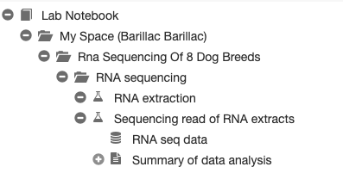
How does the process look like in openBIS?

Slide 25
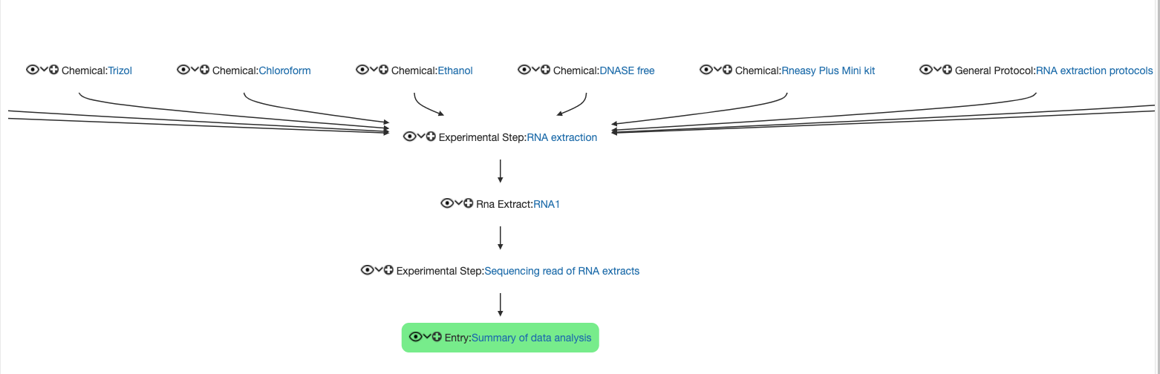
How does the process look like in openBIS?

Slide 26
Management of samples and protocols
We will register a few samples and one protocol in the inventory, covering different topics:
Single sample registration
Batch registration of samples
Batch modification of samples
How to assign storage positions to samples
How to register a standard lab protocol

Slide 27
Lab notebook
Intra breed genetic variability of dogs
RNA analysis of 8 dog breeds
RNA extraction
Sequencing read of RNA extracts
Data analysis
Fasta files
We will create 1 Project, 1 Experiment and 3 Experimental Steps in your personal space.
We will see how we can link samples and protocols stored in the Inventory to the Experimental Step.
We will upload data to the Experimental Step.

Slide 28
Practical sessions

Slide 29

Session 1
Registration and copy of tissue samples: sections 3.1.1 + 3.1.2 on pages 3, 4
Batch registration of chemical samples: section 3.1.3, page 4
Deletion of duplicate objects: section 3.1.4, page 5
15 min

Slide 30
Session 2
Batch modification of chemical samples: section 3.1.5, page 5
To do together

Slide 31
Session 3
Visualization of storage positions in the Storage Manager: section 3.2, pages 6
To do together

Slide 32
Session 4
Registration of RNA extraction protocol: section 3.3.1, page 6
To do together

Slide 33
Short break
10 min

Slide 34
Sessions 5
Registration of project and experiment: section 4.1, 4.2 pages 7,8
Registration of the first Experimental Step: section 4.3.1, pages 8, 9
Intra breed genetic variability of dogs
RNA analysis of 8 dog breeds
RNA extraction
10 min

Slide 35
Session 6
Registration of RNA extacts in Inventory: section 4.3.2 page 9
Registration of RNA sequencing Experimental Step + data upload: sections 4.3.3, 4.3.4, pages 9, 10
Intra breed genetic variability of dogs
RNA analysis of 8 dog breeds
RNA extraction
Sequencing read of RNA extracts
10 min
Fasta files

Slide 36
Session 7
Registration of Data Analysis Entry: section 4.3.5, page 10
To do together
Intra breed genetic variability of dogs
RNA analysis of 8 dog breeds
RNA extraction
Sequencing read of RNA extracts
Data analysis
Fasta files

Slide 37
Session 8
Data visualization + data export: sections 4.3.6, 4.4, page 11
To do together

Slide 38
Session 9
Assign access rights to notebook: section 4.5, page 11
Searching the ELN: sections 5.1, 5.1.1., 5.2, pages 12, 13
10 min

Slide 39
Session 10
Freezing entities: section 6, page 13
To do together

Slide 40
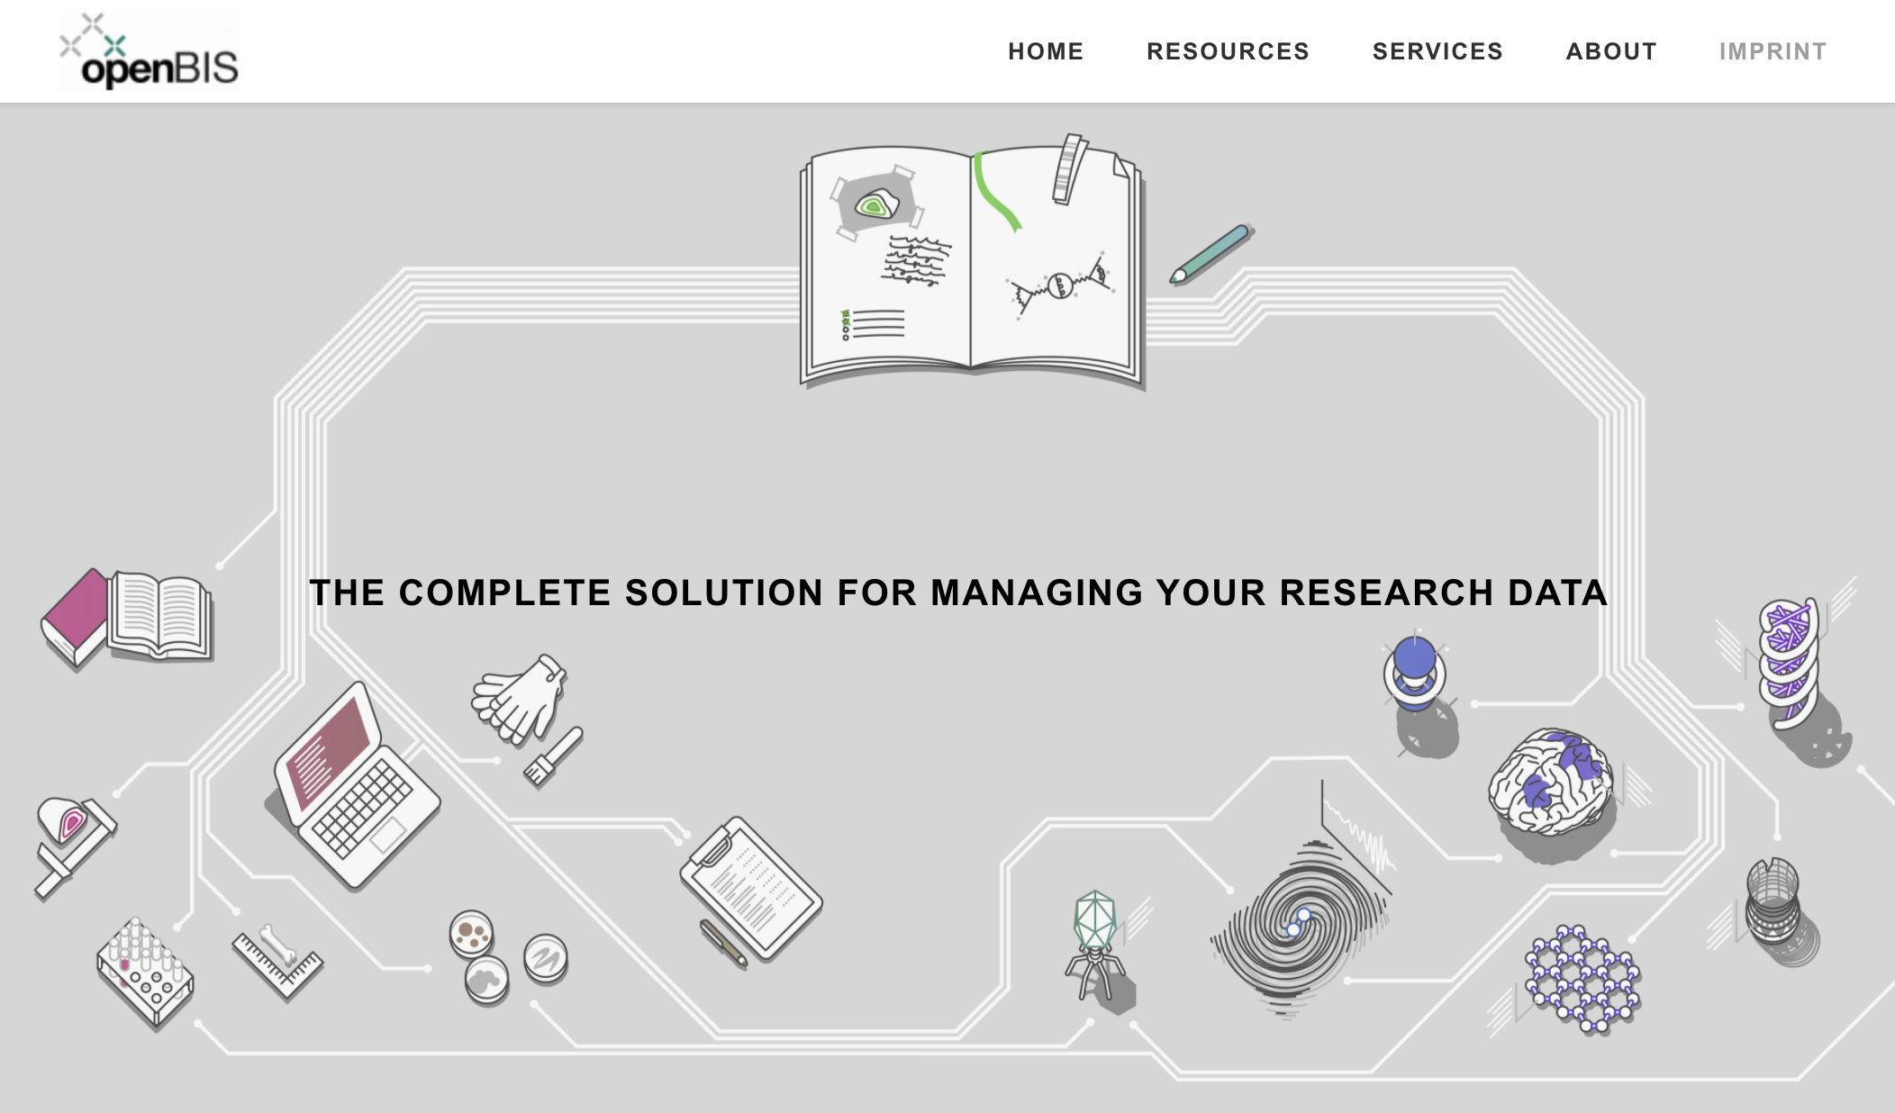

Contacts & useful info
Documentation & video tutorials: https://openbis.ch/
SIS website: https://sis.id.ethz.ch/
Twitter: https://twitter.com/ETH_SIS
Paperplane: https://www.paperplane.ethz.ch
SIS helpdesk
sis.helpdesk@ethz.ch
Caterina Barillari
caterina.barillari@id.ethz.ch
Priyasma Bhoumik
priyasma.bhoumik@id.ethz.ch

